Slide 1
The impact of the Indian Ocean and North Pacific in Austral-Asian Monsoon & ENSO in the ACCESS-CM2 piControl runs
Arnold Sullivan, Dave Bi, Harun Rashid, Christine Chung & Jiawei Liu
13 Sep. 2019

Slide 2
Background story
Understand how our new model performs Monsoon in ACCESS-CM2 piControl
Precipitation in the CM2
Double ITCZ ?? Prec. Bias??
Asia, India, Australia Monsoon?
Reviewing the roles of IO & PO in the climate system.
Eastern (Central) Pacific ENSO

Slide 3
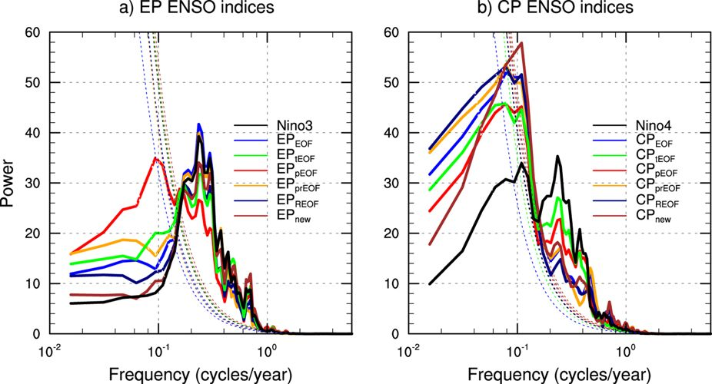
ENSO Diversity
5-7 yrs
2-7 yrs
decadal

Slide 4
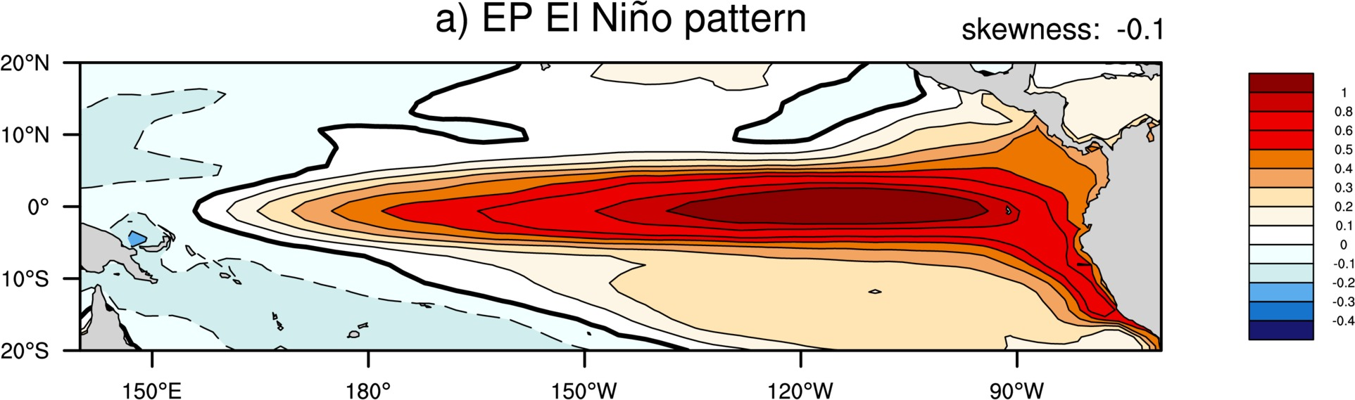
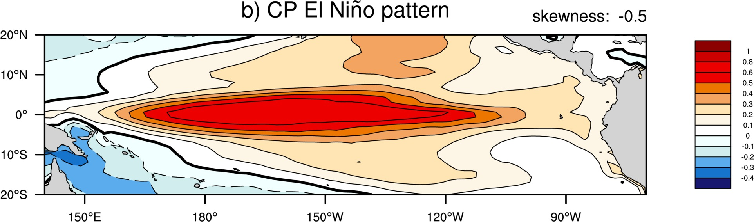
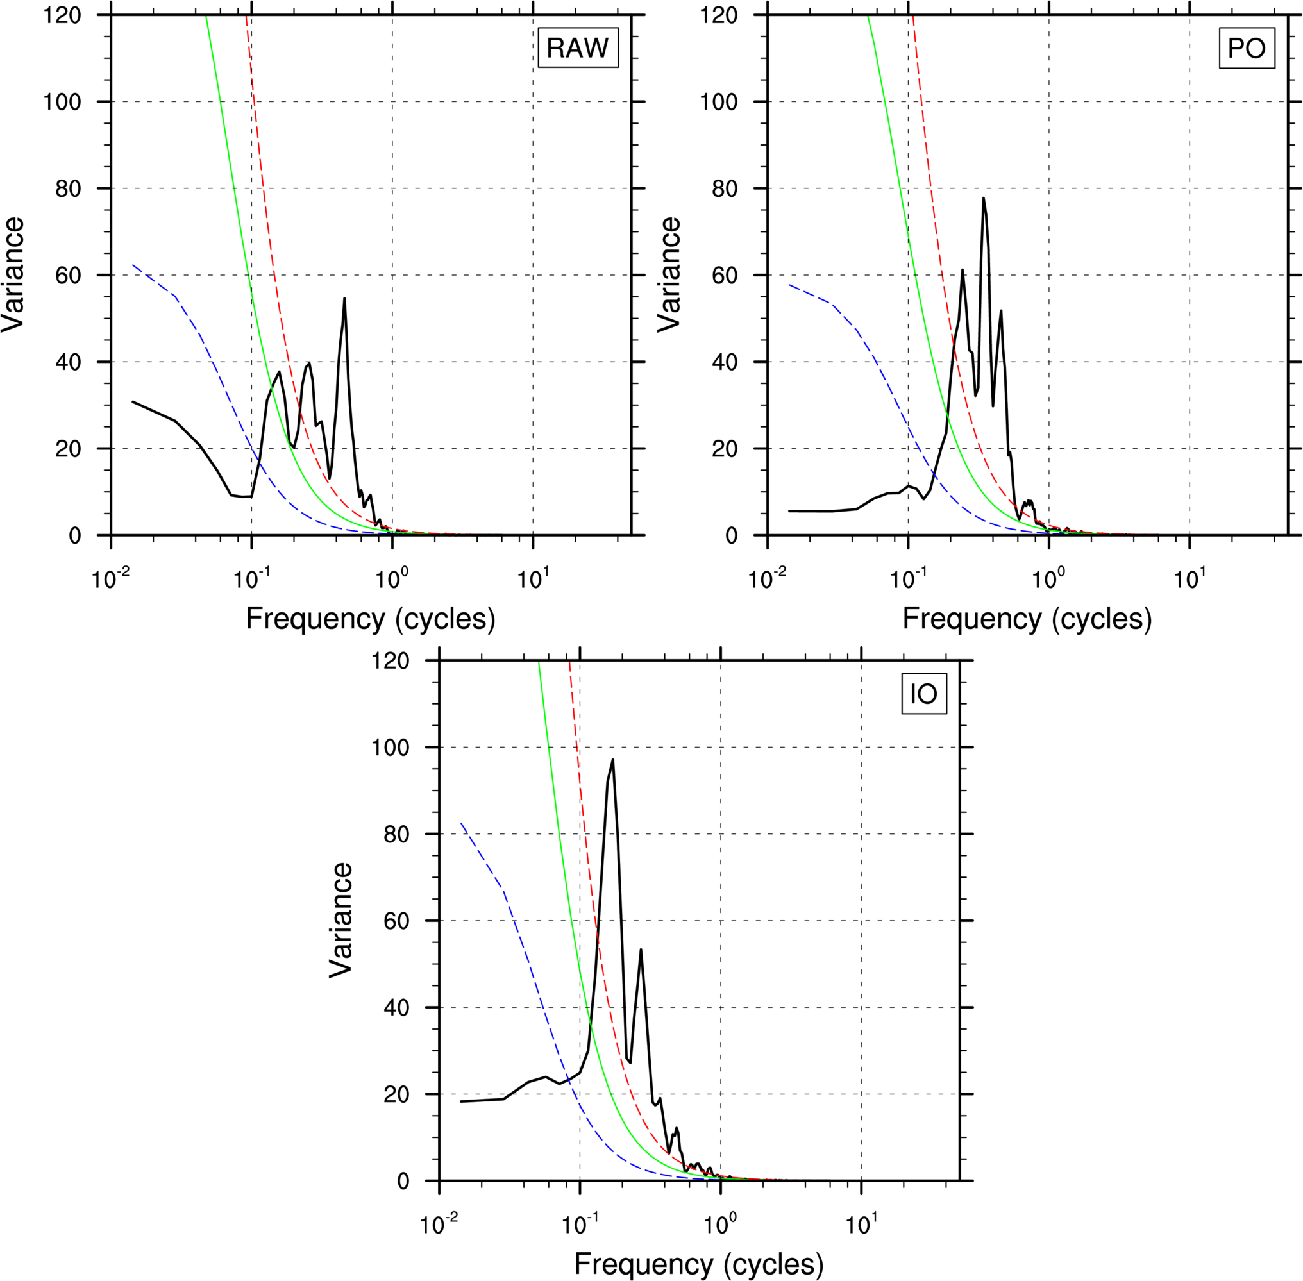
Power Spectra of Nino3.4
RAW
5 yr ->|
|<- 1 yr

Slide 5
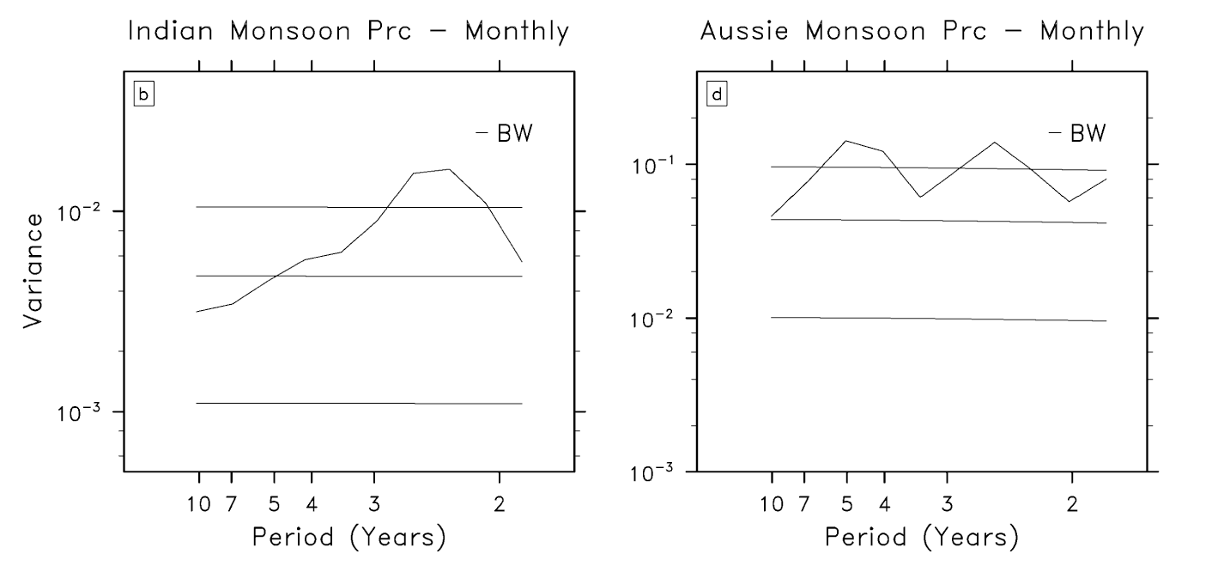
Power Spectra of Monsoon Rainfall Index
Indian Summer Monsoon
Australian Summer Monsoon
(Org from Yu: modified from Meehl and Arblaster 2002)

Slide 6
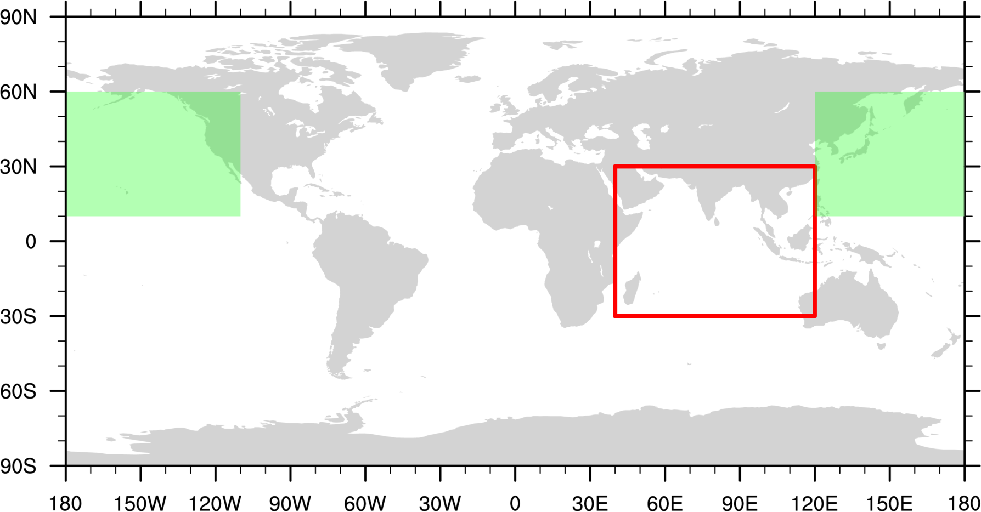
Decoupled regions
PO
IO
Simulated (T&S) replaced
by piControl climatology
Chung et al. 2019

Slide 7
Power Spectra of Nino3.4
5 yr ->|
|<- 1 yr
Power Spectra of Nino3.4
RAW
PO
IO

Slide 8
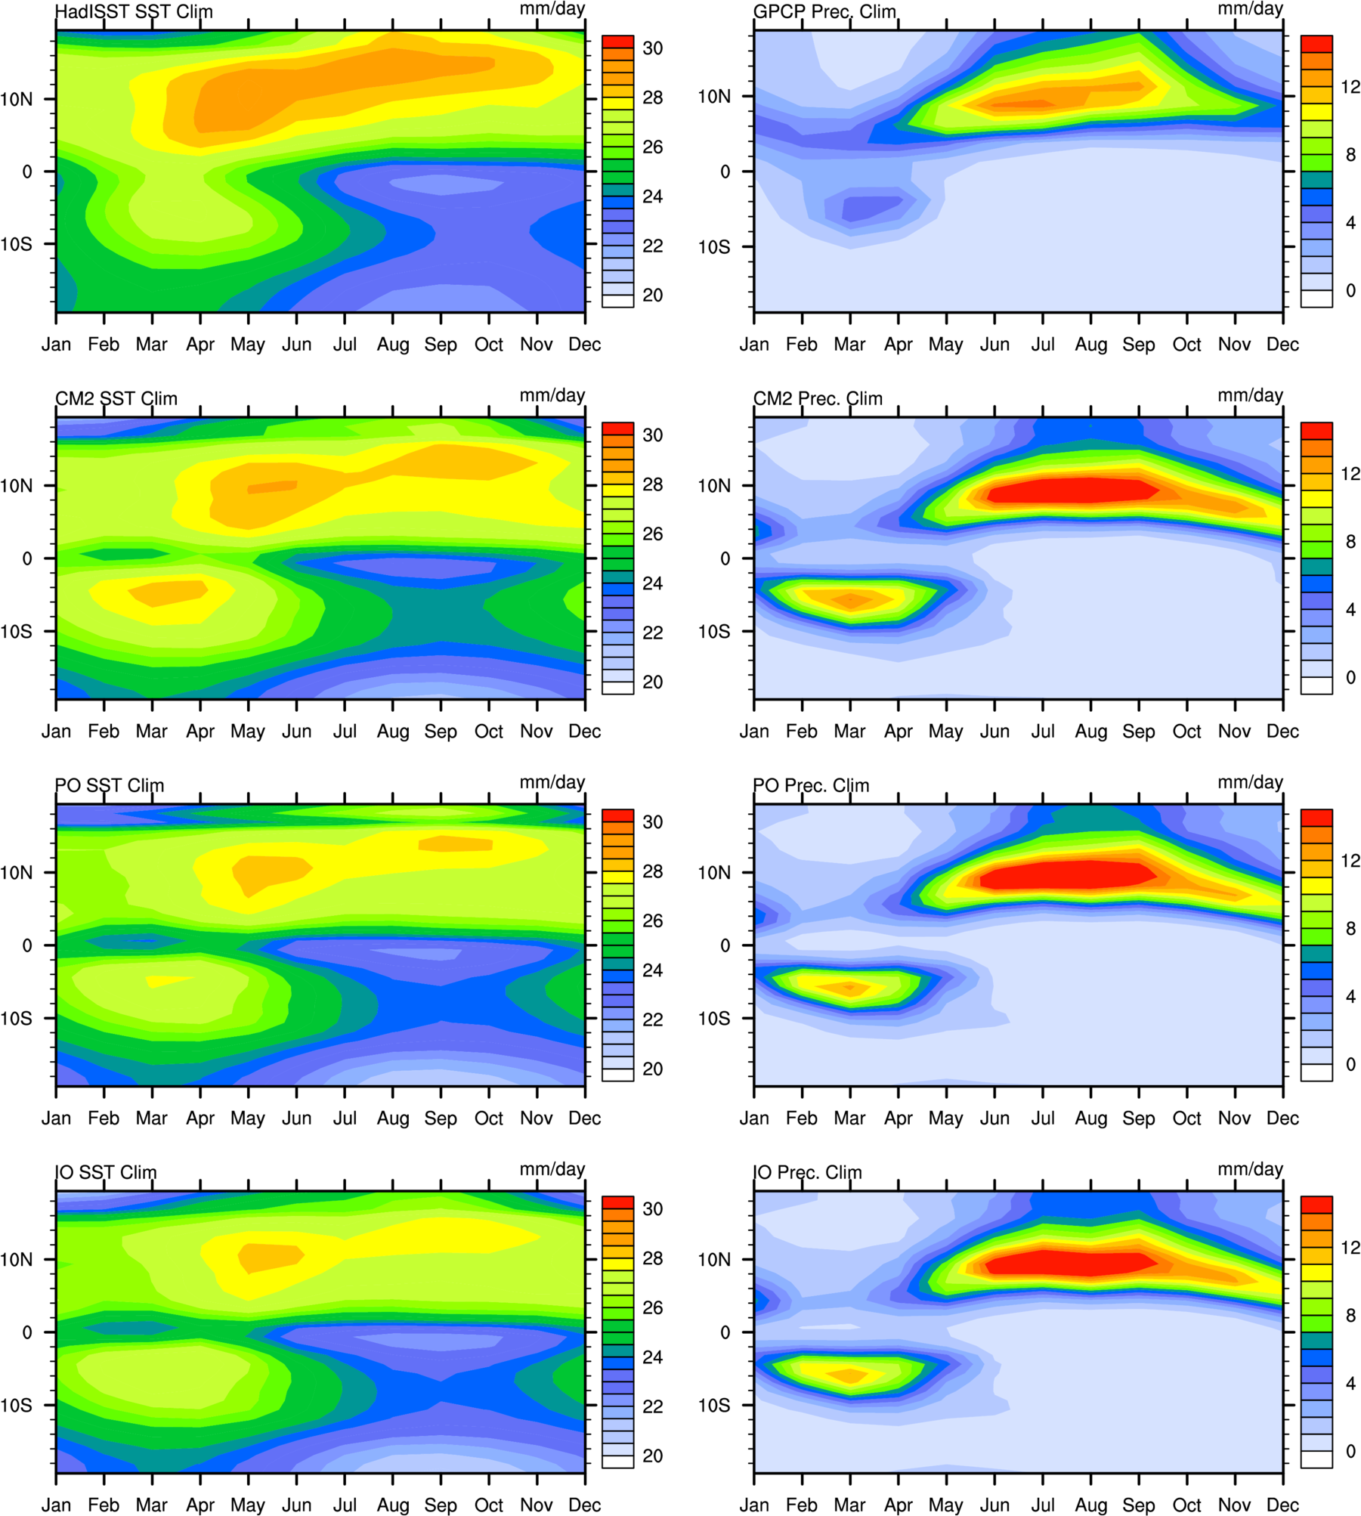
SEP Seasonal Cycle
SST
Prec.
Obs
RAW
Observational SST & Precipitation
Averaged over 90ºW-120ºW
Checking Double-ITCZ Bias in CM2
PO
IO
Song & Zhang 2019

Slide 9
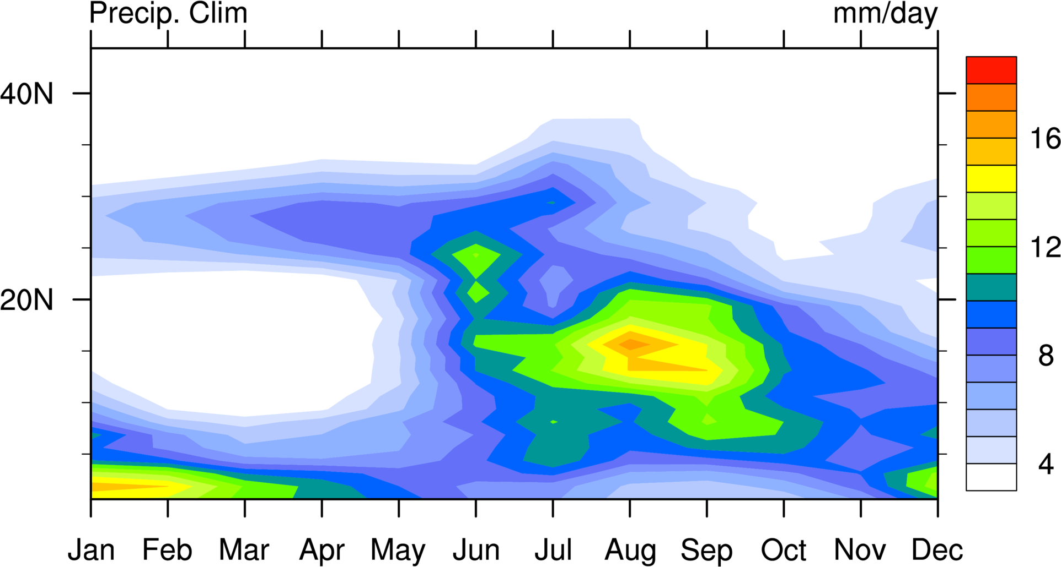
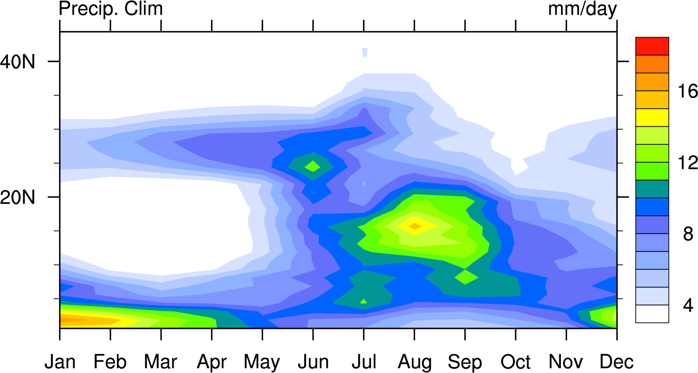
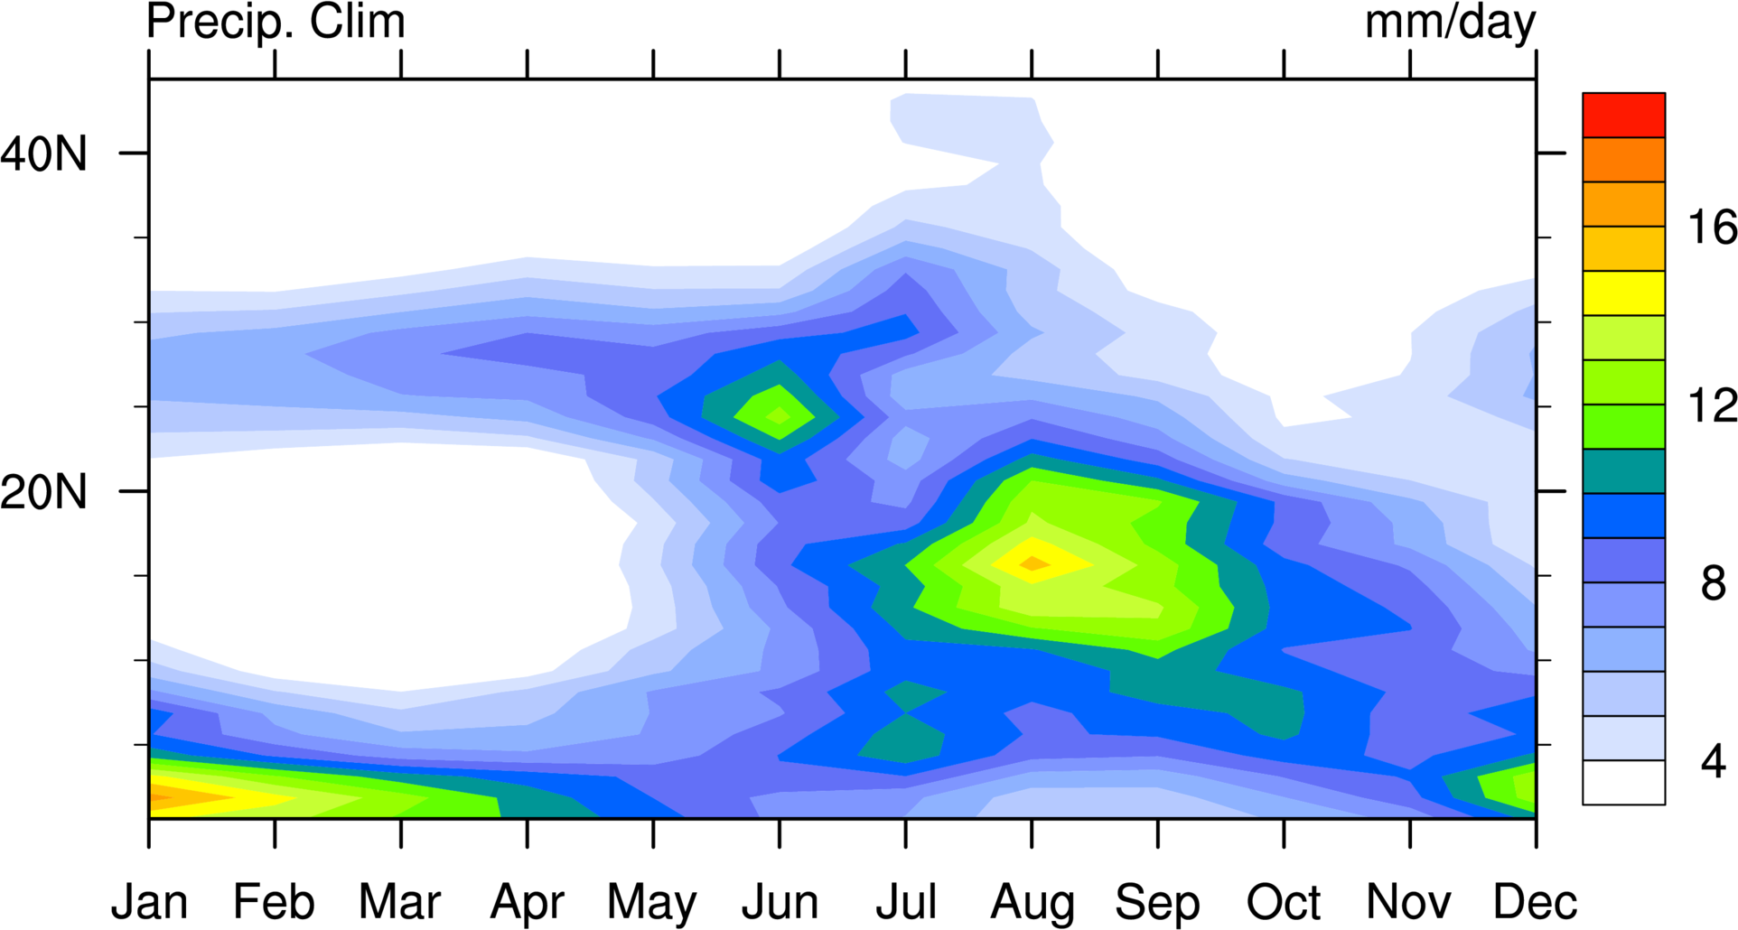
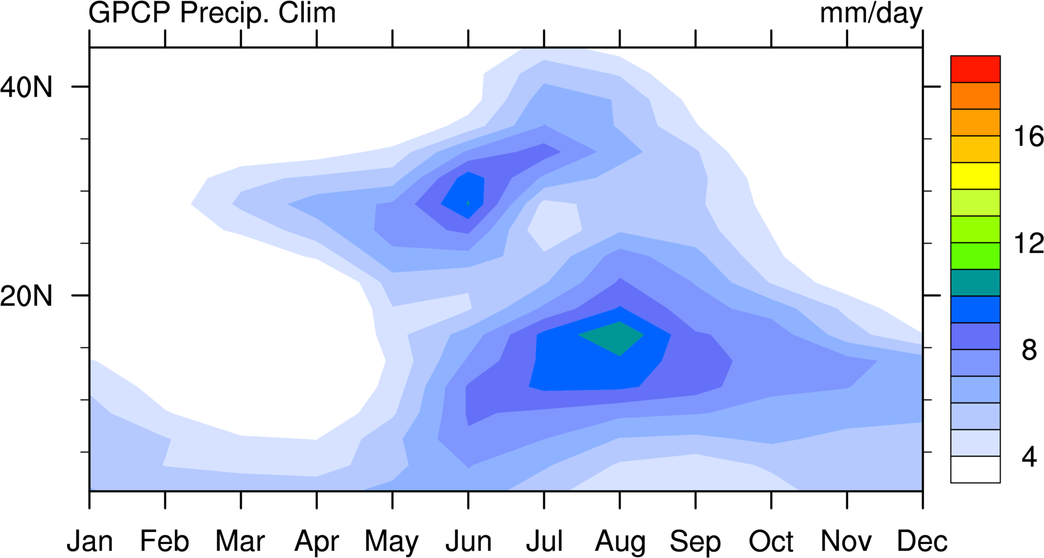
WNP-EA Seasonal Cycle
RAW
Western North Pacific-Eastern Asia
Averaged over 115ºE-135ºE
Checking precipitation Bias in CM2
PO
Obs
Chou et al. 2008
IO

Slide 10
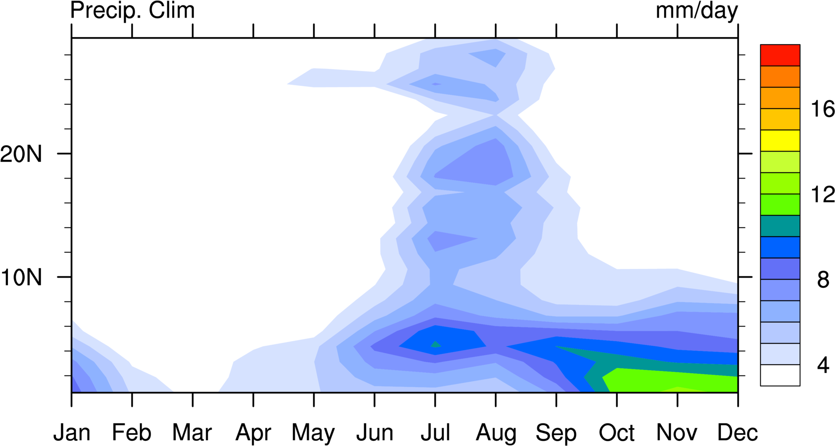
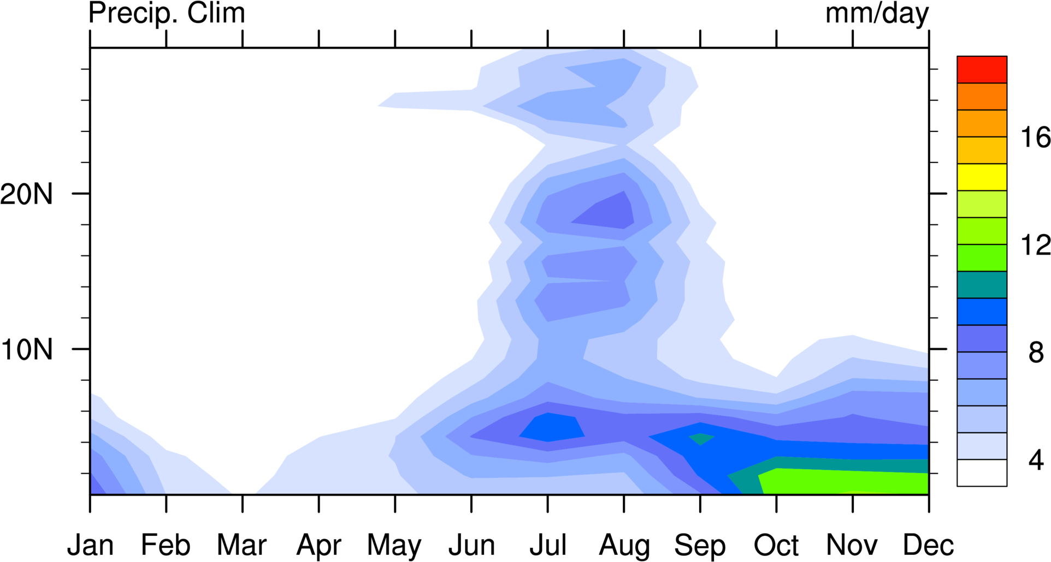
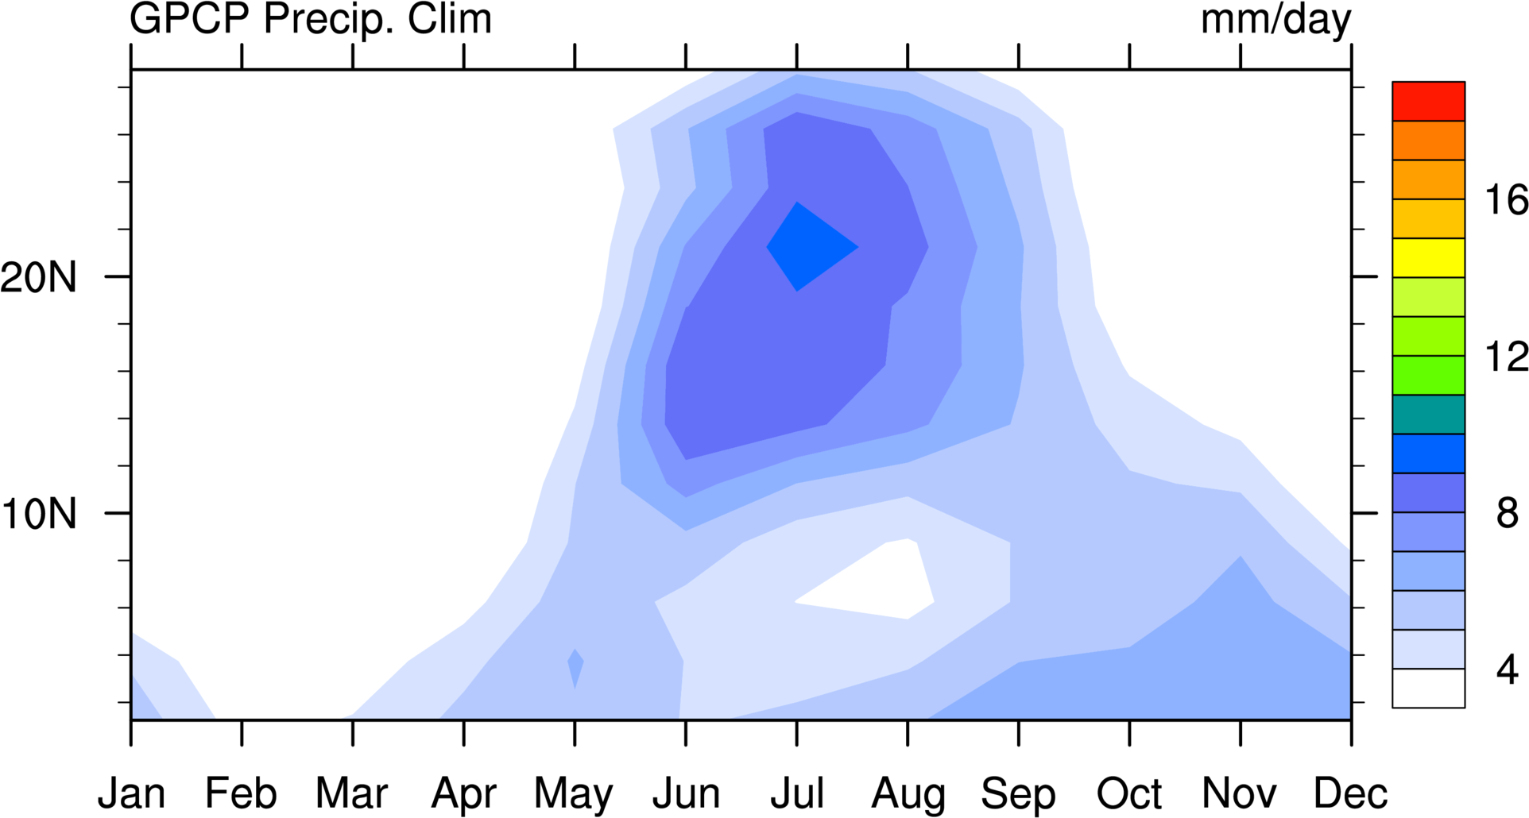
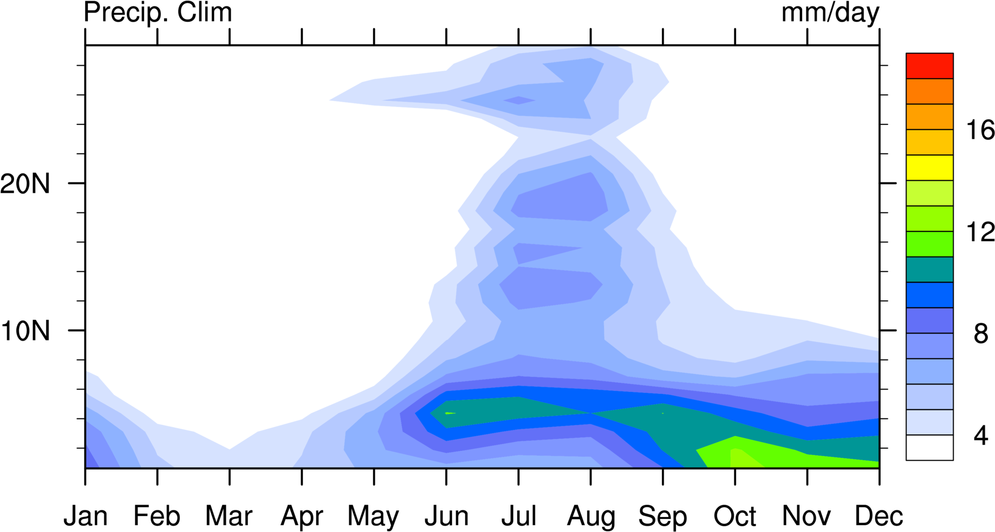
RAW
Indian Seasonal Cycle
Observational Precipitation
Averaged over 60ºE-100ºE
Checking precipitation Bias in CM2
PO
IO
Obs

Slide 11
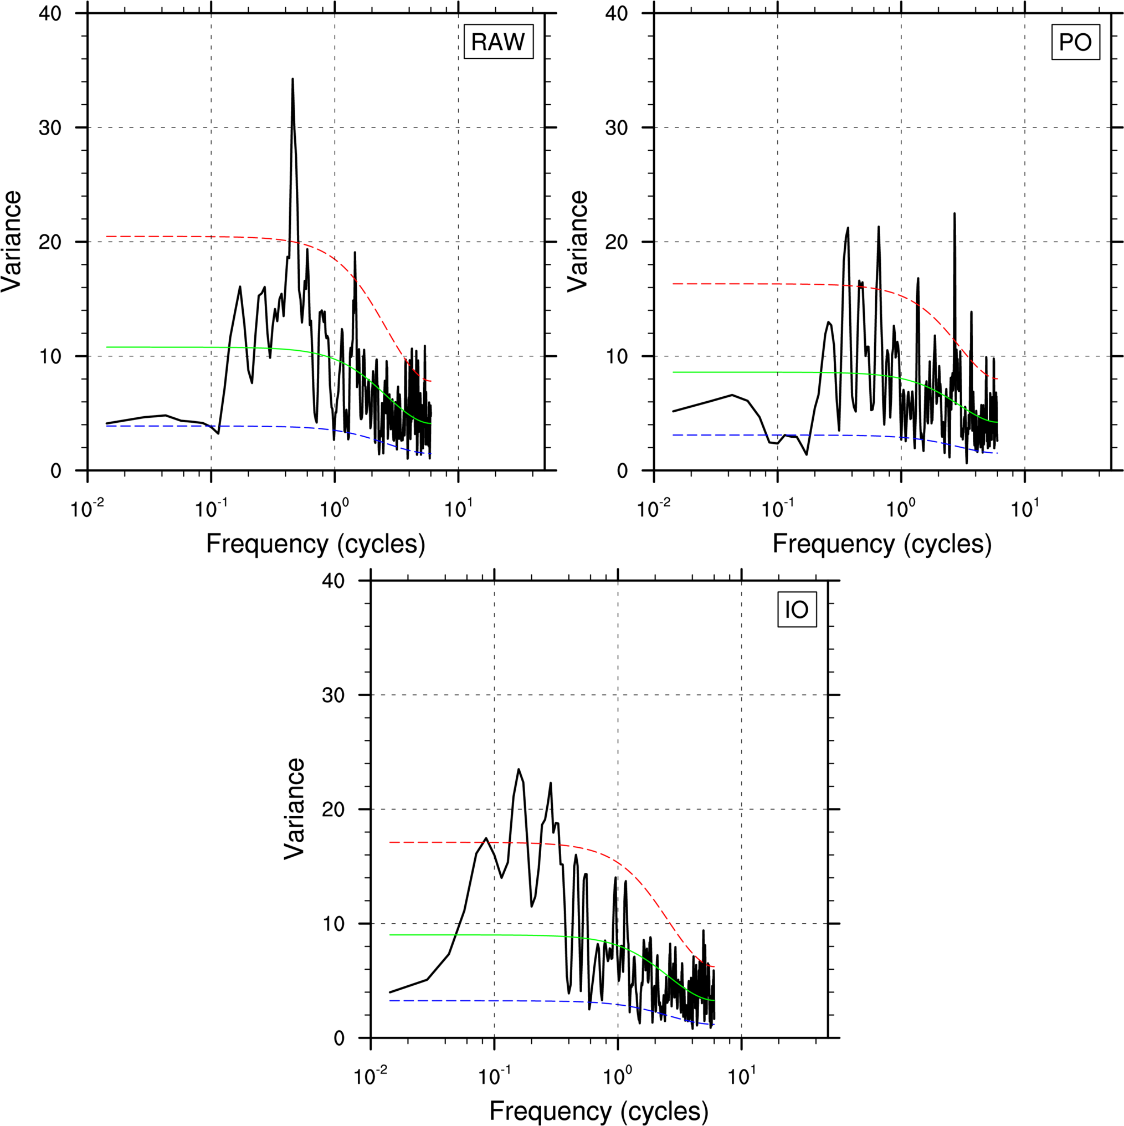
Power Spectra of Australia Monsoon
5 yr ->|
|<- 1 yr
RAW
PO
IO
U850 averaged over 2.5ºS-15ºS, 110ºE-150ºE

Slide 12
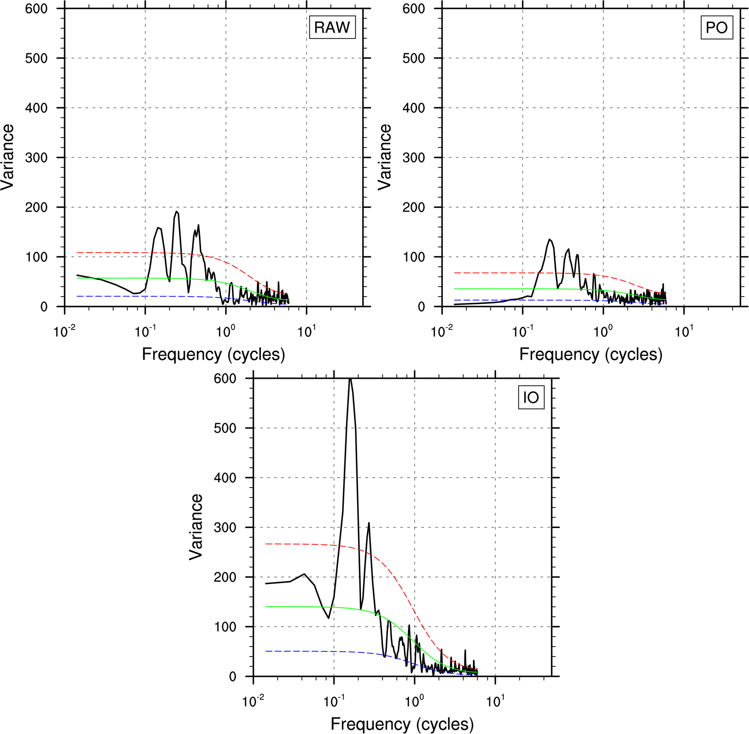
Power Spectra of WYMI
5 yr ->|
|<- 1 yr
RAW
PO
IO
U850-U200 averaged over
0-20ºN, 40ºE-110ºE

Slide 13
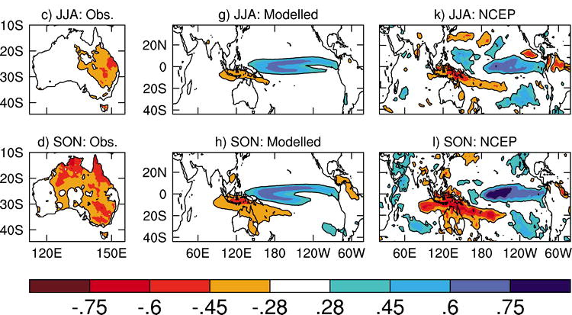
ENSO Induced Precipitation
Cai, W. A Sullivan, T Cowan: Rainfall teleconnections with Indo-Pacific variability in the WCRP CMIP3 models. Journal of climate 22 (19), 5046-5071 (2009).

Slide 14
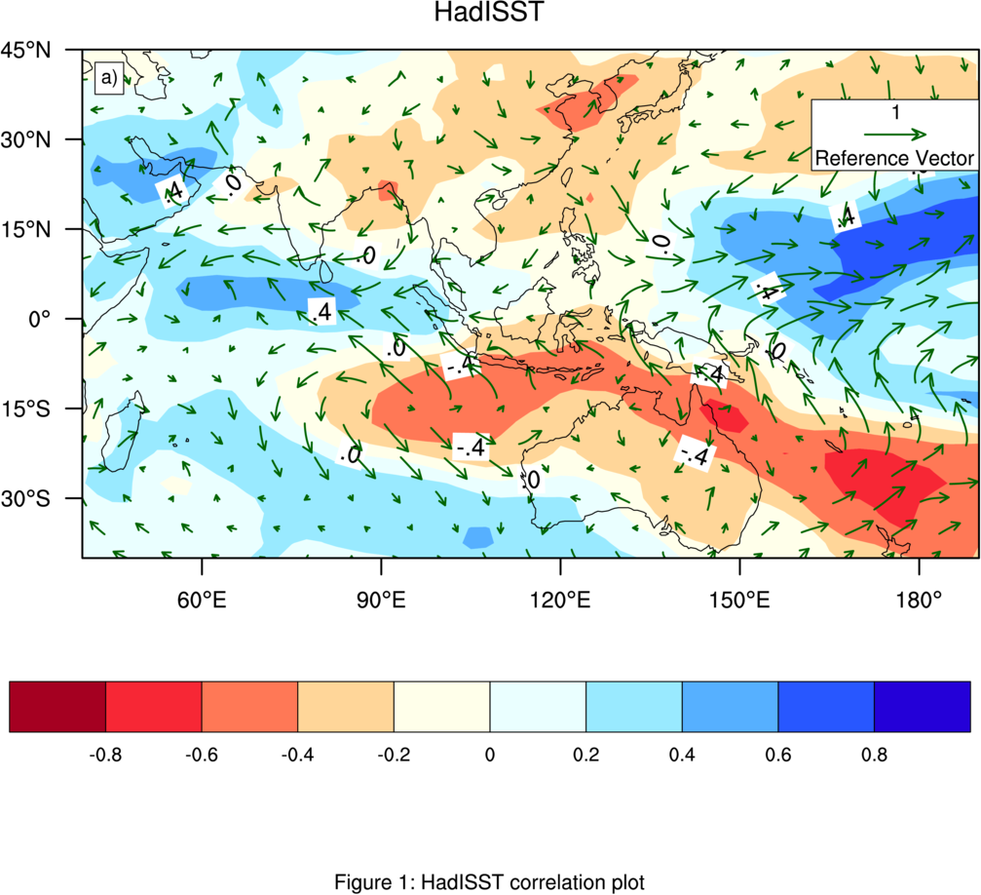
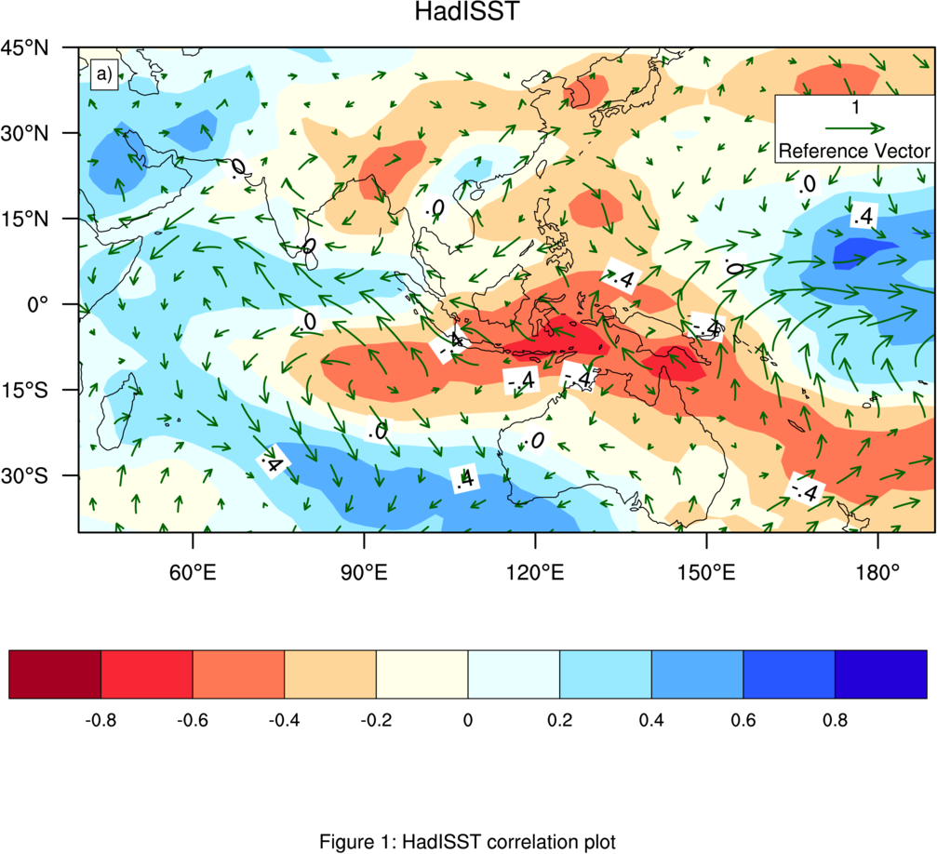
SON: NCEP vs ENSO from HadISST
CP
EP

Slide 15
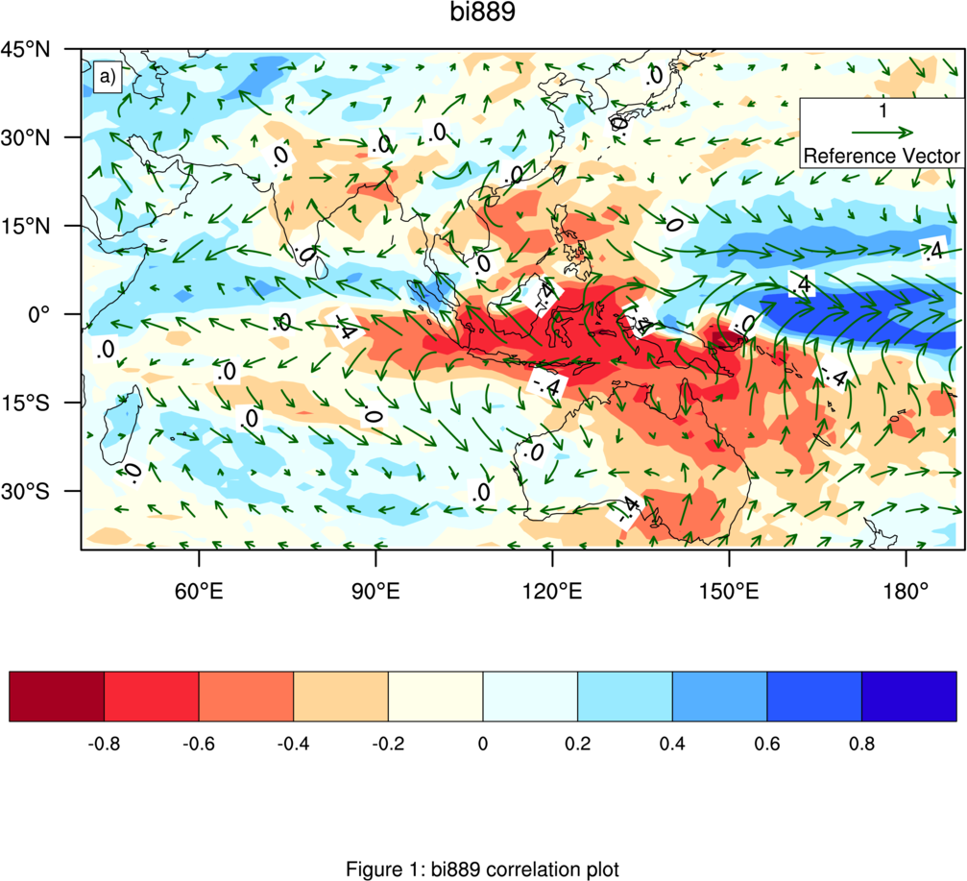
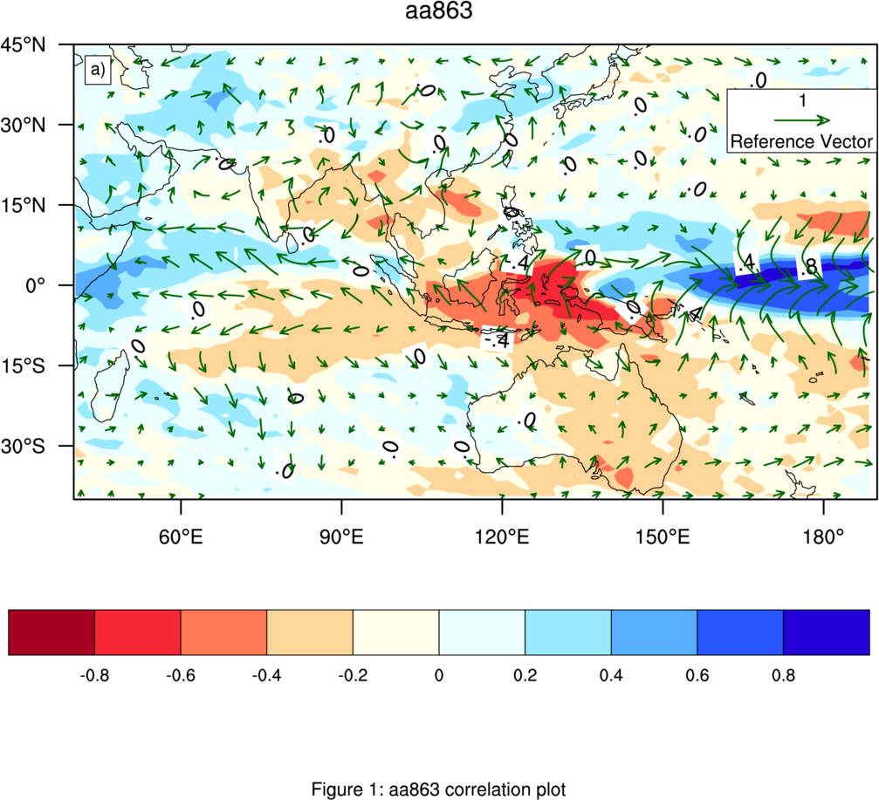
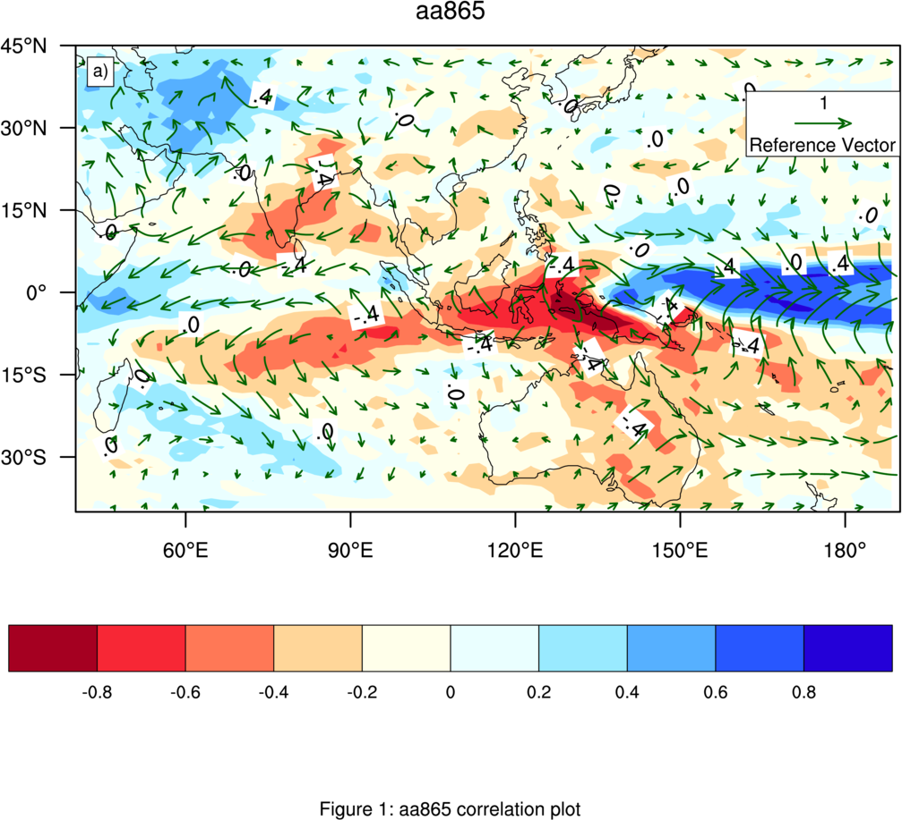
SON: CP ENSO Induced Precipitation
OBS
RAW
PO
IO

Slide 16
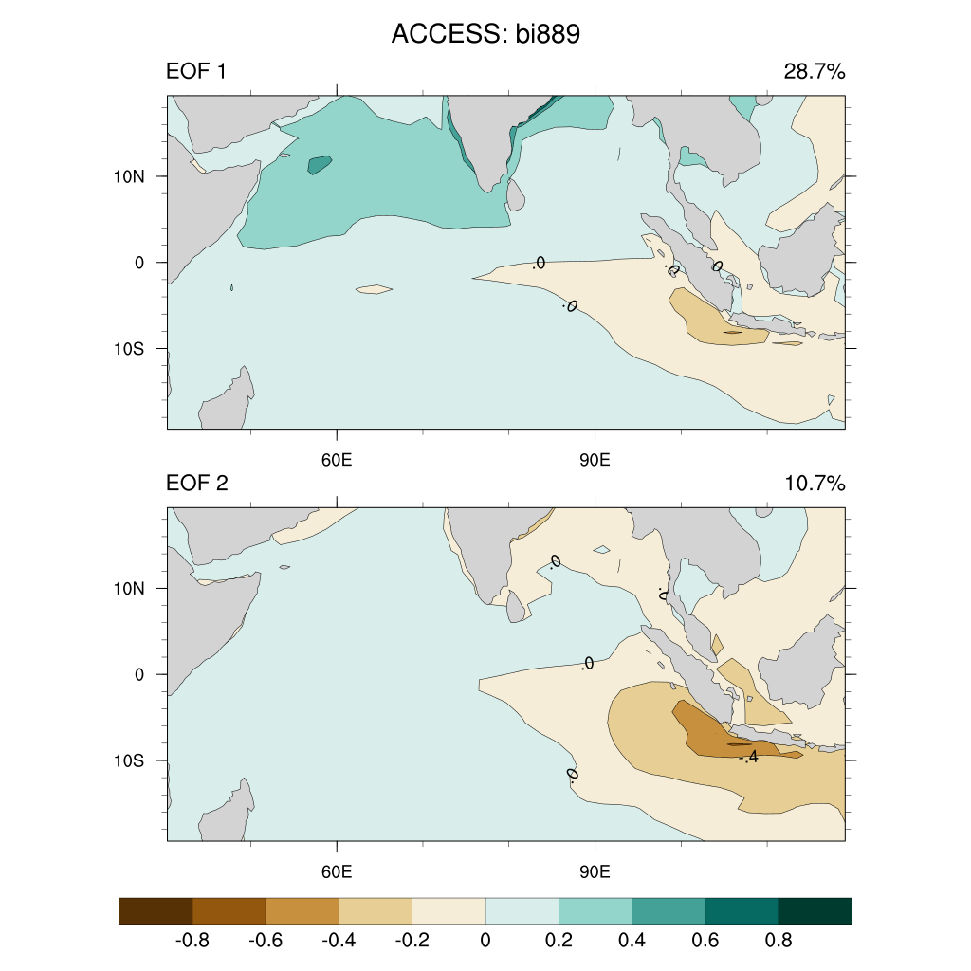
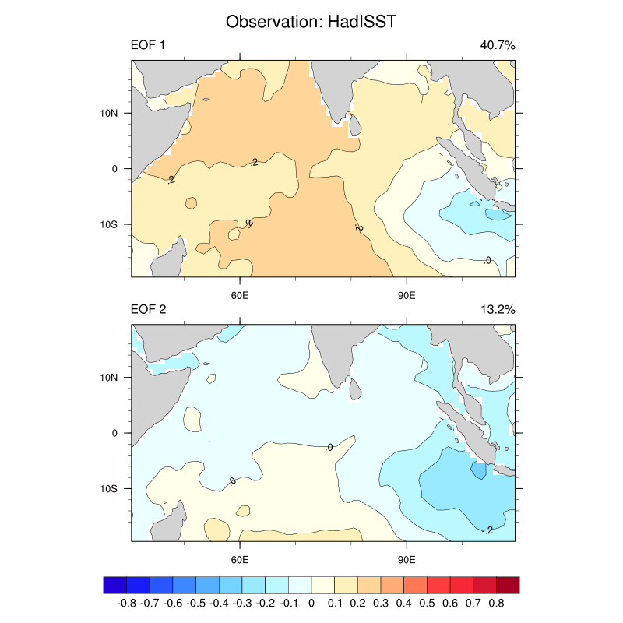
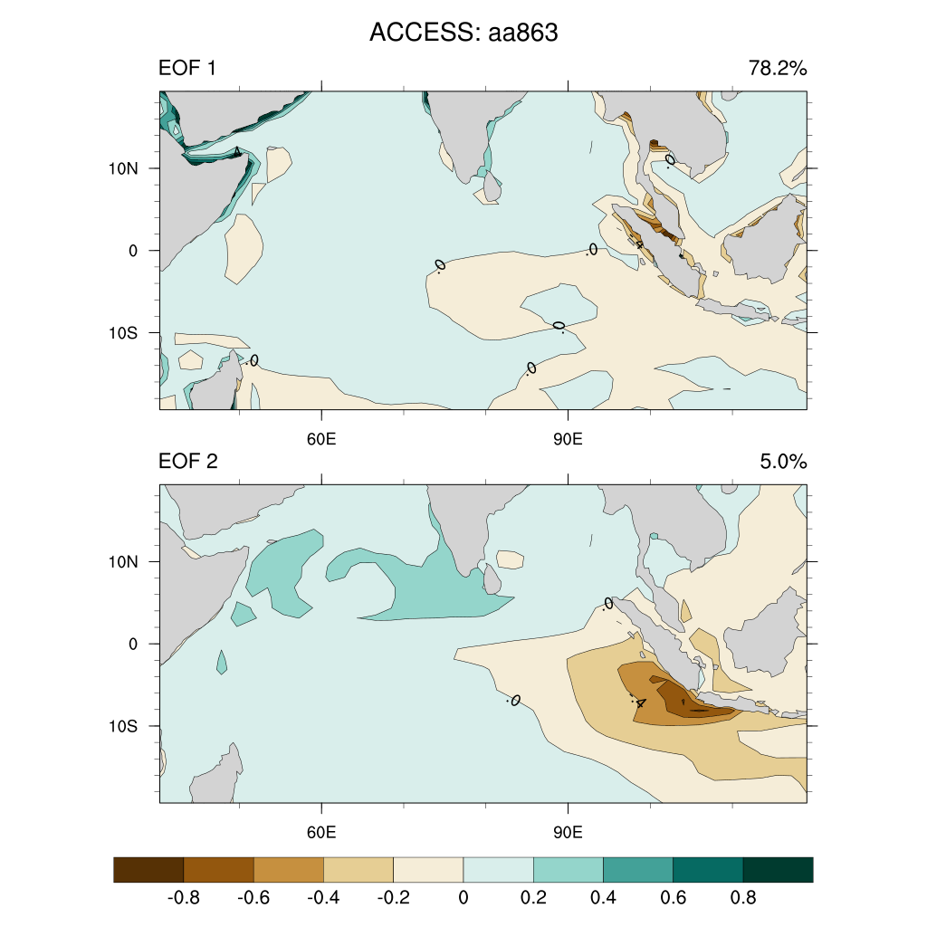
IOD Patterns
OBS
RAW
PO

Slide 17
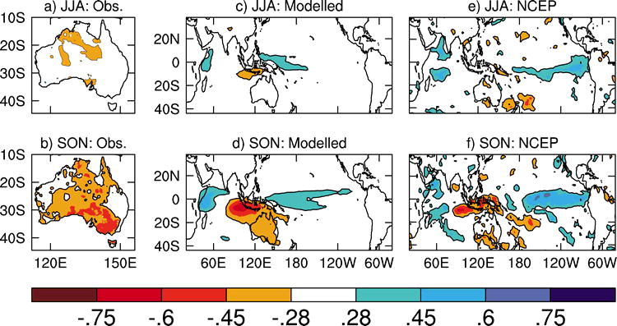
IOD Induced Precipitation
Cai, W. A Sullivan, T Cowan: Rainfall teleconnections with Indo-Pacific variability in the WCRP CMIP3 models. Journal of climate 22 (19), 5046-5071 (2009).

Slide 18
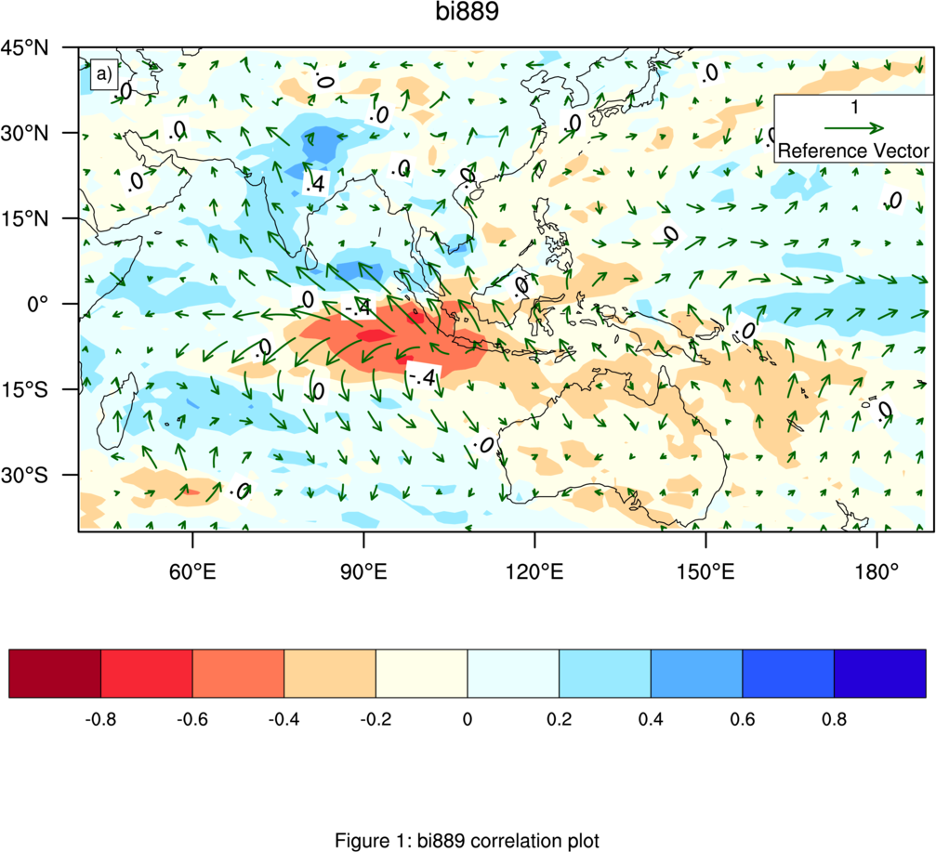
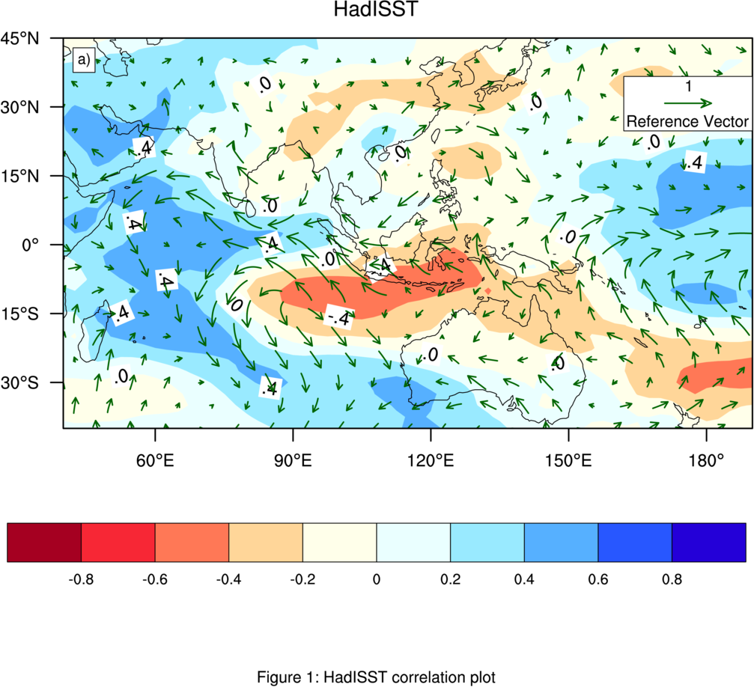
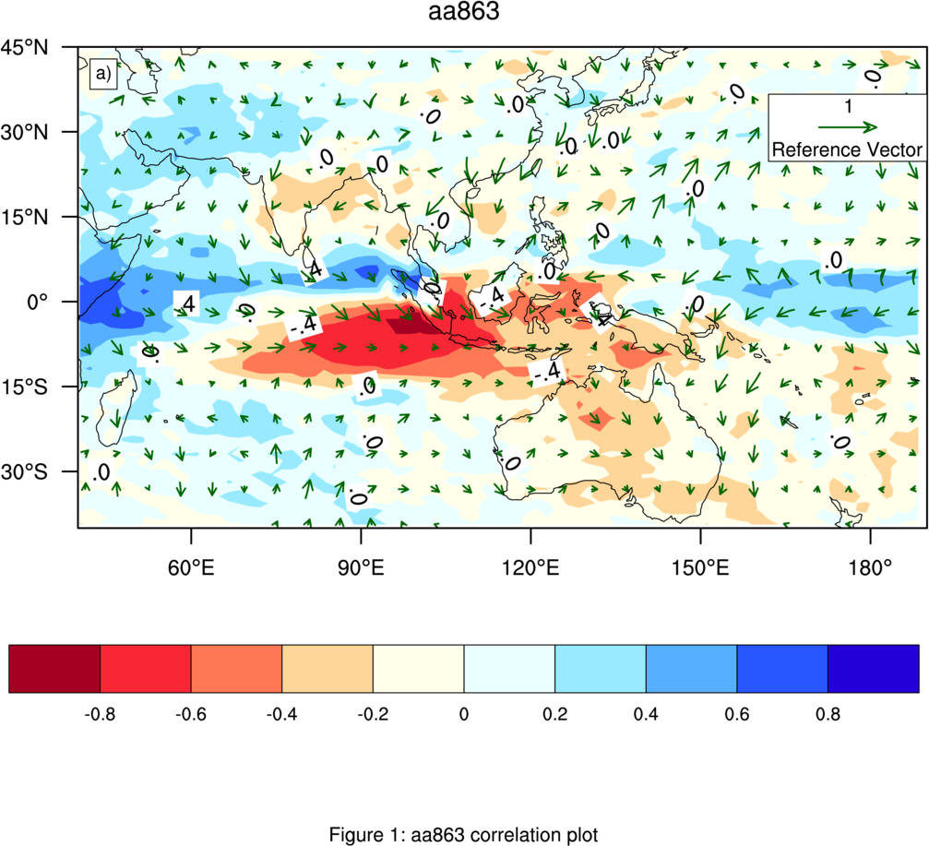
SON: IOD Induced Precipitation
RAW
OBS
PO

Slide 19
Summary
Double ITCZ attributed to the warm SST + Compare to Observation Atmosphere Model is more sensitive
Generally all right on Asia, India, Australia monsoon simulation
IO exp: High frequency part of ENSO reduced
Northern PO exp: ENSO is stronger than RAW

Slide 20
Arnold Sullivan | Arnold.Sullivan@csiro.au +61 3 9239 4525

